Slide 1

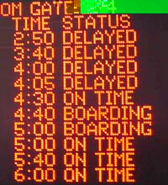
PROJECT:
FLIGHT DELAY PREDICTION
Sujana Veeraganti
10360479
Prof. Mahmoud Daneshmand

Slide 2
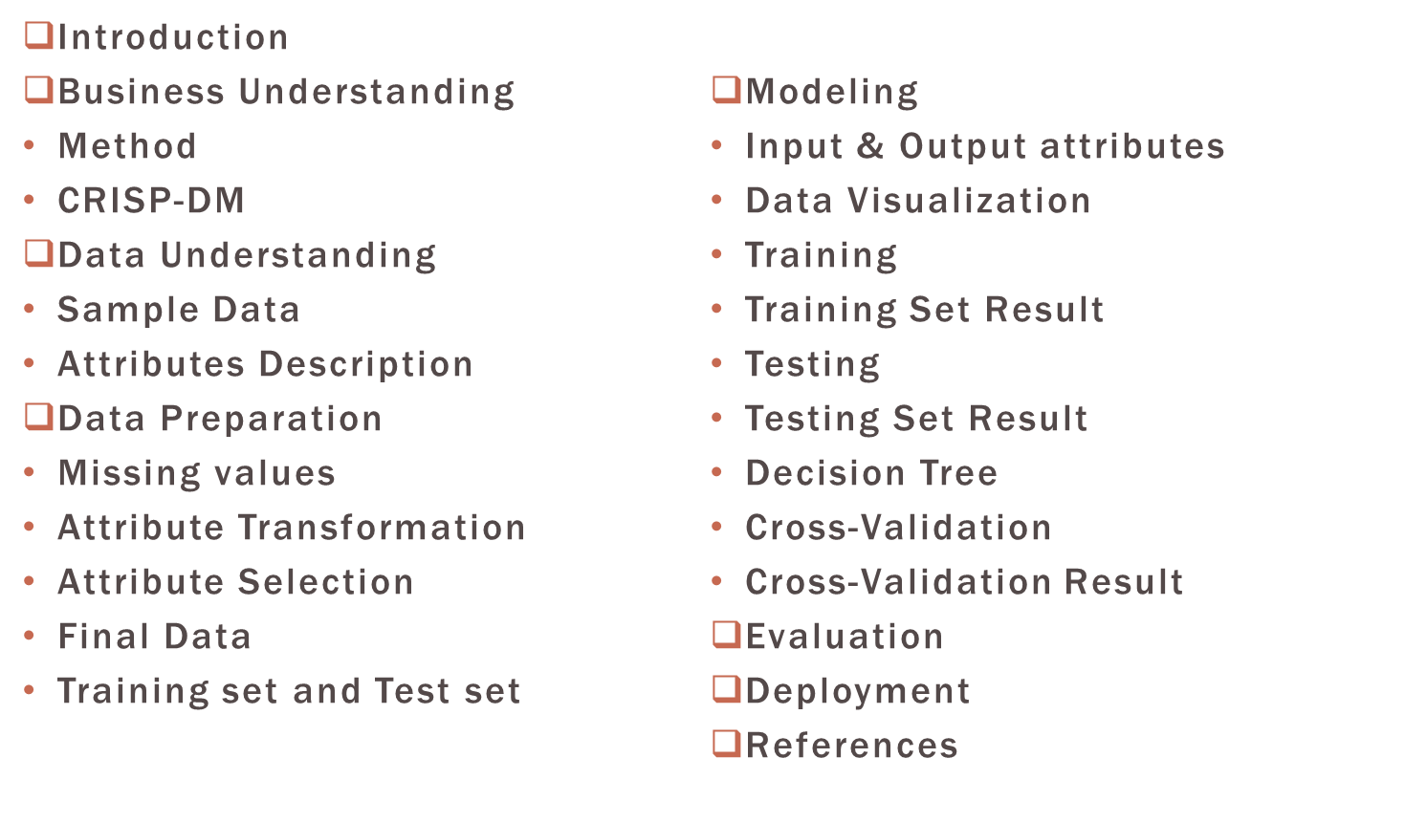
OUTLINE
MIS 637 Knowledge Discovery in Databases

Slide 3

INTRODUCTION
Flight delay and cancellations are a serious and inevitable problem part of the air travel in the United States. As the flight delays have been increasing its affecting the United States aviation and also cost passengers, airlines with huge billions of dollars every year.
There was a recent study performed by FAA showed that passengers in the United States lose about $16 billion a year due to “schedule buffer, delayed flights, flight cancellations, and missed connections”. Therefore there is a need to analyze the flight delay times.
MIS 637 Knowledge Discovery in Databases
Notes:
This single statement highlights the importance of on time performance by airlines and represents a need for passengers as well as airlines and airport authorities to accurately ascertain in advance if a flight is going to be delayed so that alternate measures can be taken to bypass the situation or rectify it to a considerable extent.

Slide 4
BUSINESS UNDERSTANDING
Profound Question
Can we build a model to predict from the flight on-time performance database if a given departure time of a particular flight will be delayed?
Using this data, can we predict whether the flights in the future will be delayed or not.
MIS 637 Knowledge Discovery in Databases

Slide 5
METHOD
First a model would be built to search for patterns or characteristics that are helpful in determining whether a flight would be delayed.
Then use this data, future flight data would be entered into this model to predict whether those particular flights also will be delayed.
The CRISP-DM process is used to solve the problem.
MIS 637 Knowledge Discovery in Databases

Slide 6
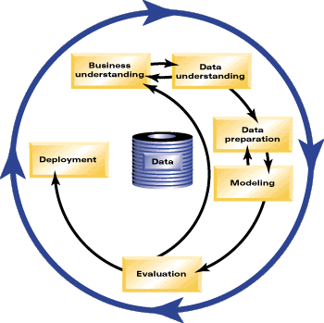
CRISP-DM*
CRISP-DM(Cross Industry Standard Process for Data Mining) is a data mining process model that describes commonly used approaches that data miners use to tackle problems. There are 6 phases:
  Business Understanding
    Determine the business objective
    Assess the situation and determine
    the data mining goals
    Produce a project plan
  Data Understanding
    Collect initial data and describe it
    Explore and verify the data quality
*http://en.wikipedia.org/wiki/Cross_Industry_Standard_Process_for_Data_Mining

Slide 7
CRISP-DM (CONTD.)
  Data Preparation
    Select and clean the data from missing values and outliers
    Construct, integrate and format the data for analysis
  Modeling
    Select data modeling technique and generate test design
    Build models and assess the model
  Evaluation
    Evaluate the results
    Determine the next steps
  Deployment
    Plan the deployment
    Plan monitoring and maintenance
    Produce final report
MIS 637 Knowledge Discovery in Databases

Slide 8
Data Source
RITA*, Research and Innovative Technology Administration database of the Bureau of Transportation Statistics.
This database provides details for every flight that takes off anywhere in the US.
It consists of 93 attributes that are categorical variables such as year, month, day, flight date, unique carrier code, flight number, tail number of the airplane, origin airport code, destination airport code, time of departure, departure delay, time of arrival, arrival delay, cancellations, diversions, distance flown, total air time etc.
To provide a sense of the amount of data available, the month of December 2011 consists of 636,000 rows of data.
More than half a million flights take off every month in the US !!!
MIS 637 Knowledge Discovery in Databases
*http://www.transtats.bts.gov/

Slide 9

DATA UNDERSTANDING
There is an extensive amount of flight statistical data available, which would be useful to variety of organizations: airport authorities, airlines, aviation authorities.
The scope of the problem is restricted to:
Chicago to New-York route, as its the top domestic route during September 2011 – August 2012.
Due to the huge amount of data available. The data was only collected for the period December 2011.
This data consists of all flights from the Chicago area into the New York City area.
The Chicago area airports (ORD and MDW) and New York City area airports (JFK, EWR and LGA) are the busiest airports and both the cities are commercial hubs.
MIS 637 Knowledge Discovery in Databases
*http://www.transtats.bts.gov/
Notes:
Such organization can benefit from some advance notice about flights that are likely to be delayed.

Slide 10
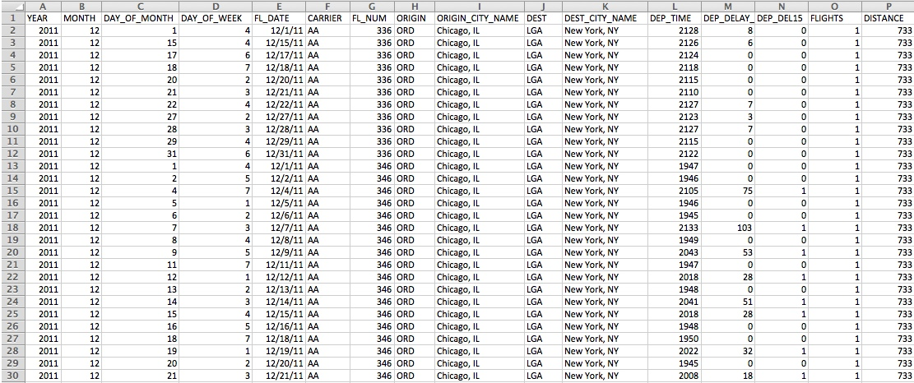
SAMPLE DATA

Slide 11
ATTRIBUTES DESCRIPTION*
YEAR: Year
MONTH: Month
DAY_OF_MONTH: Day of the Month (1-31)
DAY_OF_MONTH: Day of the Week (1-7 i.e. Monday through Sunday)
FL_DATE: Date of the Flight (yyyymmdd)
CARRIER: Code assigned by IATA and commonly used to identify a carrier. (AA - American Airlines, CO – Continental Airlines
B6 - JetBlue Airways, MQ - American Eagle
UA – United Airways, WN – Southwest Airlines
XE – ExpressJet Airlines )
MIS 637 Knowledge Discovery in Databases
*http://www.transtats.bts.gov/DL_SelectFields.asp?Table_ID=236&DB_Short_Name=On-Time

Slide 12
ATTRIBUTES DESCRIPTION (CONTD.)
FL_NUM: Flight Number
ORIGIN: Origin Airport Codes (ORD – O’Hare International Airport, MDW – Midway International Airport)
ORIGIN_CITY_NAME: Origin Airport, City Name
DEST: Destination Airport Codes (JFK – John F. Kennedy International Airport, EWR – Newark Liberty International Airport, LGA – LaGaurdia Airport)
DEST_CITY_NAME: Destination Airport, City Name
MIS 637 Knowledge Discovery in Databases

Slide 13
ATTRIBUTES DESCRIPTION (CONTD.)
DEP_TIME: Actual Departure time (local time: hhmm) (0000-24000)
DEP_DELAY_NEW: Difference in minutes between scheduled and actual departure time. Early departures set to 0
DEP_DELAY_15: Departure Delay Indicator, 15 minutes or more. (1-YES and 0-NO)
FLIGHTS: Number of flights
DISTANCE: Distance between airports (miles)
MIS 637 Knowledge Discovery in Databases

Slide 14

DATA PREPARATION
Most of the data from the RITA database was consistent except for a few missing values.
The DEP_TIME, DEP_DELAY_NEW, DEP_DEL15 instances had some missing values and these rows of data were deleted. As this may be due to due to flight cancellations or rescheduling of those particular flights.
And also some instances were deleted like the YEAR and MONTH because we are using the data for the a particular period that is December 2011.
FL_DATE was deleted because we had the same information in DAY_OF_MONTH and DAY_OF_MONTH.
FL_NUM was also deleted because the flight number is not required for the data analysis.
MIS 637 Knowledge Discovery in Databases

Slide 15
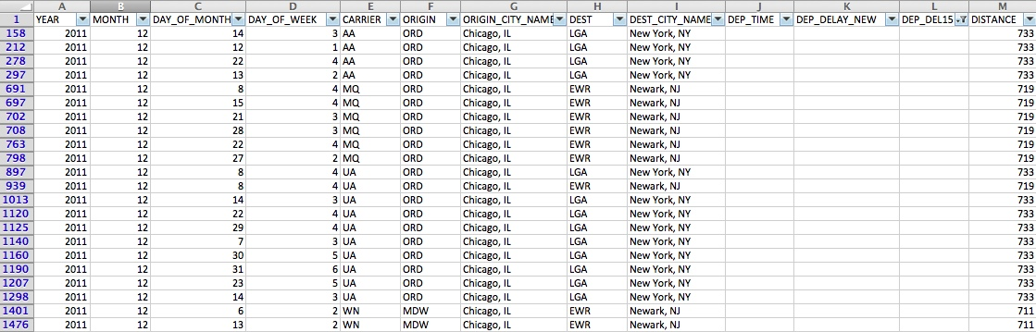
MISSING VALUES
The rows with missing values were deleted.
MIS 637 Knowledge Discovery in Databases

Slide 16
ATTRIBUTES TRANSFORMATION
The target attribute DEP_DELAY15 has two combinational values (0 and 1).
The dataset explains 1 if DEP_DELAY15 < 15 minutes and 0 otherwise.
So, the target attribute is transformed as follows:
Records with DEP_DELAY15 value 0 are coded as No.
Records with DEP_DELAY15 value 1 are coded as Yes.
This transformation helps in easier classification of the data.
MIS 637 Knowledge Discovery in Databases

Slide 17
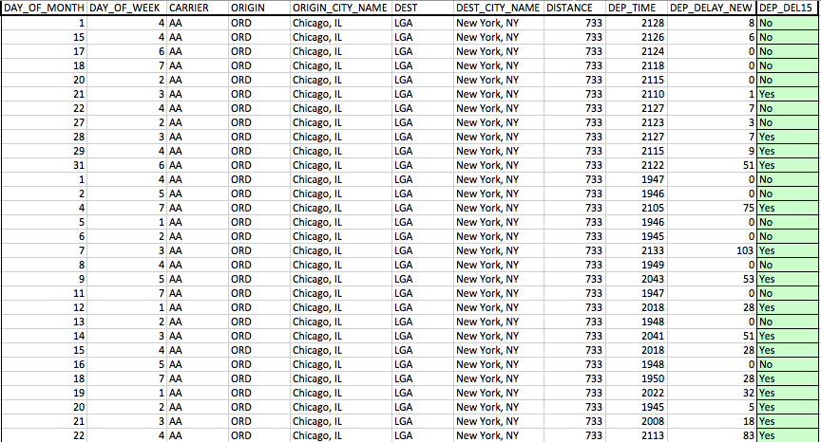
ATTRIBUTES TRANSFORMATION

Slide 18
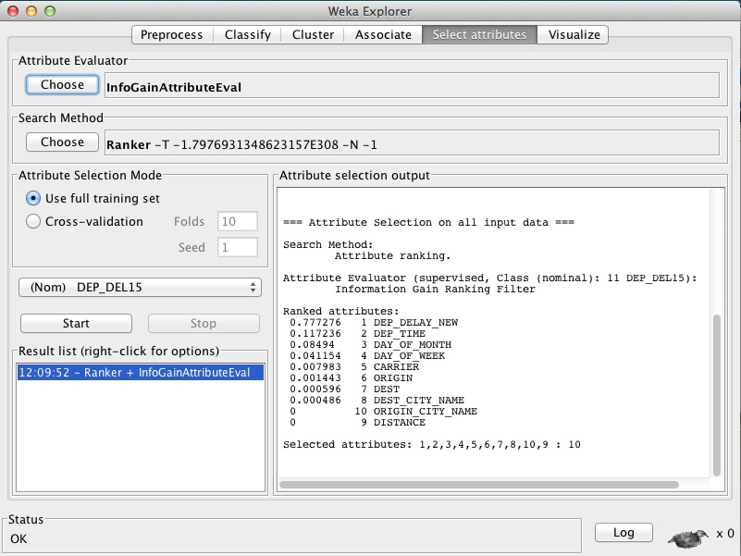
ATTRIBUTE SELECTION
WEKA is used in selection of attributes.
For this we make use of the Information-Gain Attribute Evaluator and Ranker Search Method to understand the importance of the attributes in our data.

Slide 19
ATTRIBUTE SELECTION(CONTD.)
According to the results, the attributes DEP_DELAY_NEW, DEP_TIME, DAY_OF_MONTH, DAY_OF_WEEK have more contribution and effect on the prediction than CARRIER, ORIGIN and DEST.
The attribute ORIGIN_CITY_NAME has no contribution and this is true because we are considering only one city that is Chicago, Illinois.
The attribute DISTANCE has no contribution and this is true because all the flights will follow the route Chicago to New York where the distance will approximately be the same.
In the final dataset, all the attributes are placed according to the attribute ranking and the target/output variable is DEP_DEL15.
MIS 637 Knowledge Discovery in Databases

Slide 20
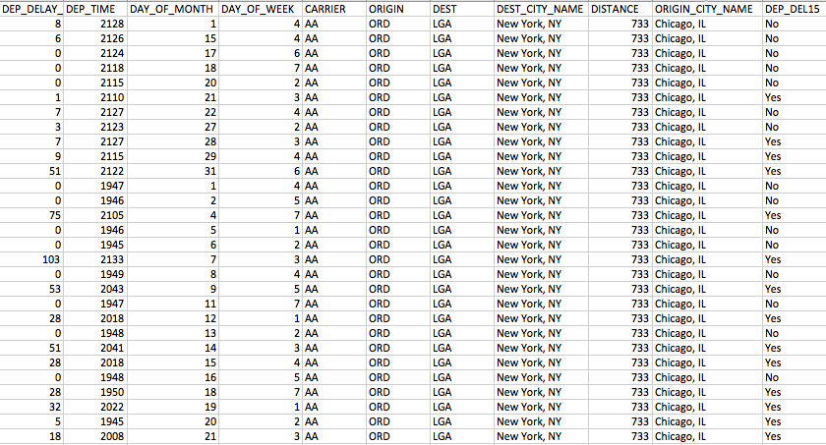
FINAL DATA

Slide 21
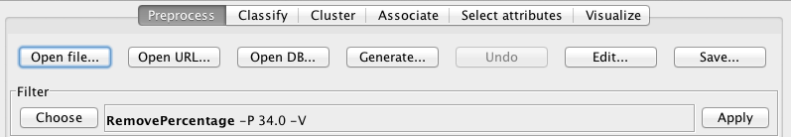
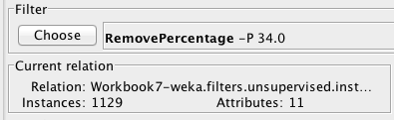
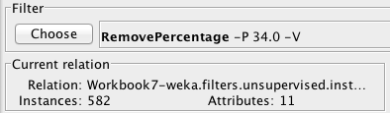
TRAINING SET AND TEST SET
The final data is divided into two parts with the help of Weka, using the ‘RemovePercentage’ filter.
Training Set: This data is used to train the model.
1129 records are used to train the data.
Test Set: This data is used to check the accuracy of the training by the model from the training dataset.
582 records are used in the Test set.

Slide 22


MODELING
Software Used
Weka (Waikato Environment for Knowledge Analysis), version 3.6.8 is a popular suite of machine learning software written in Java, developed at the University of Waikato, New Zealand. Weka is free software available under the GNU General Public License.*
The Weka workbench contains a collection of visualization tools and algorithms for data analysis and predictive modeling, together with graphical user interfaces for easy access to this functionality.
The flight statistical data consists of categorical variables and it can be used on discrimination, linear models or classification.
*http://en.wikipedia.org/wiki/Weka_(machine_learning)

Slide 23

MODELING
The Classification data mining technique is used, which is a technique that predicts categorical class labels and classifies data (i.e. it constructs a model) based on the training set and the values (class labels) in a classifying attribute and uses it in classifying new data.
The C4.5 algorithm (statistical classifier) is used. This is an extension of ID3 algorithm. C4.5 recursively visits each decision node, selecting the optimal splits, until no further splits are possible. It makes use of the concept of information gain or entropy reduction to select the optimal split.
MIS 637 Knowledge Discovery in Databases
Notes:
“The ability of a machine to improve its performance based on previous results.”
So, machine learning document classification is “the ability of a machine to improve its document
classification performance based on previous results of
document classification”.

Slide 24
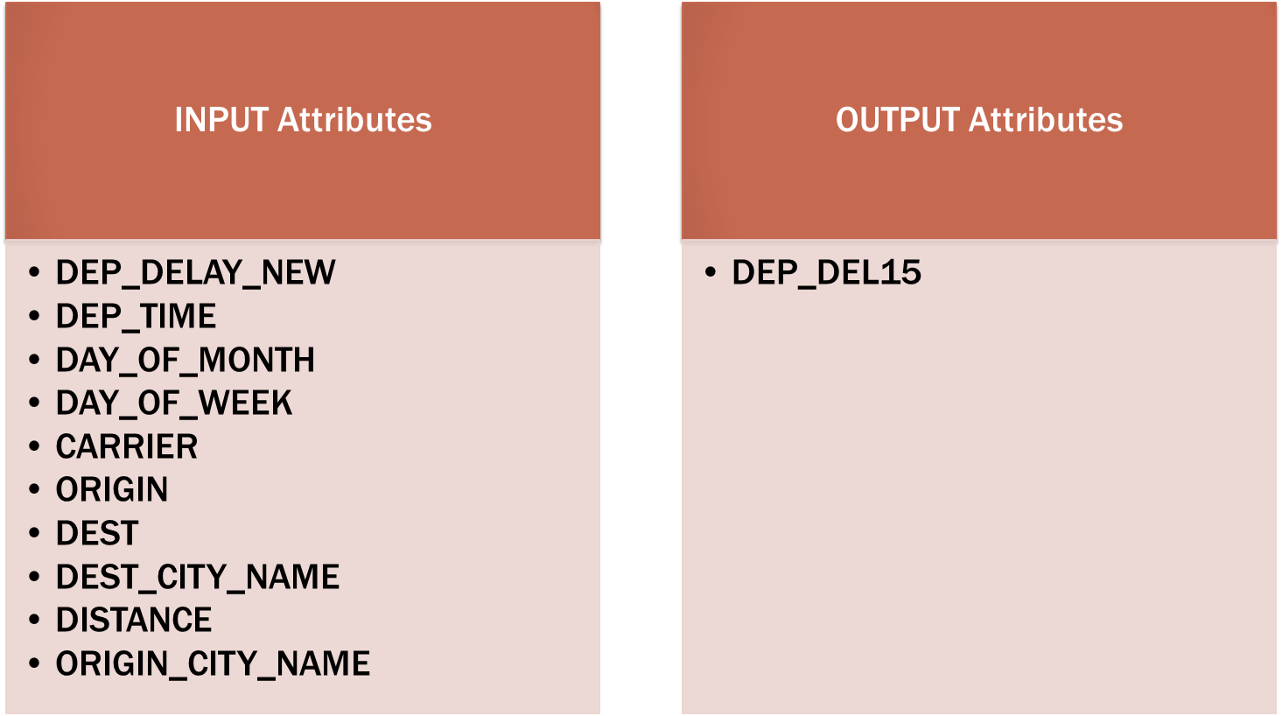
INPUT & OUTPUT ATTRIBUTES
MIS 637 Knowledge Discovery in Databases

Slide 25
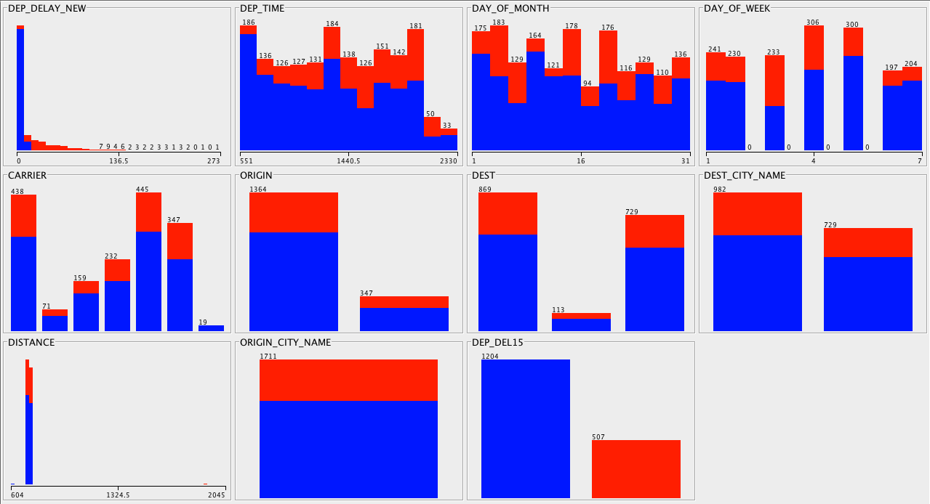
DATA VISUALIZATION
MIS 637 Knowledge Discovery in Databases

Slide 26
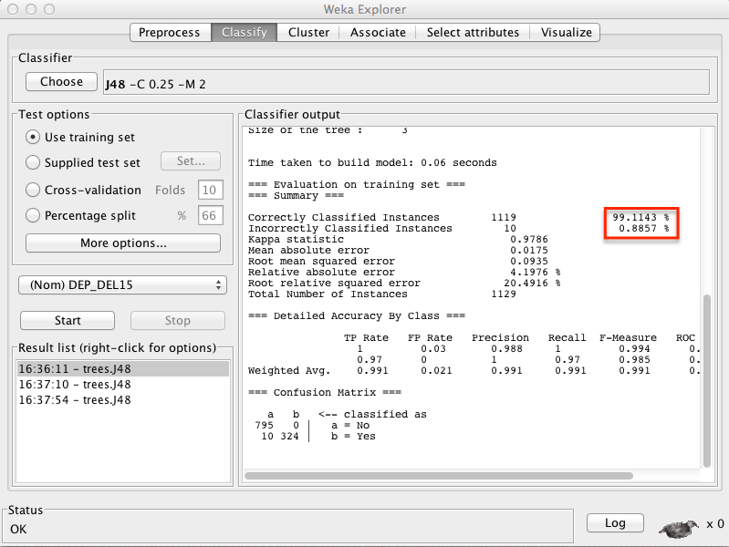
TRAINING
Using Weka, the Model is trained.
Choose Classifier as J48, which is equal to C4.5
Choose Test Options as Use Training Data.
Define class attribute as DEP_DEL15, which is the target/output attribute.
Notes:
The number of correctly classified instances are 1119/1129 records with an accuracy of 99.1143 %
The confusion matrix shows that there were total 324 flights that were delayed. 0 out of 324 are classified as wrong.
Also 805 of total flights which were not delayed. 10 out of these have been classified wrong.

Slide 27
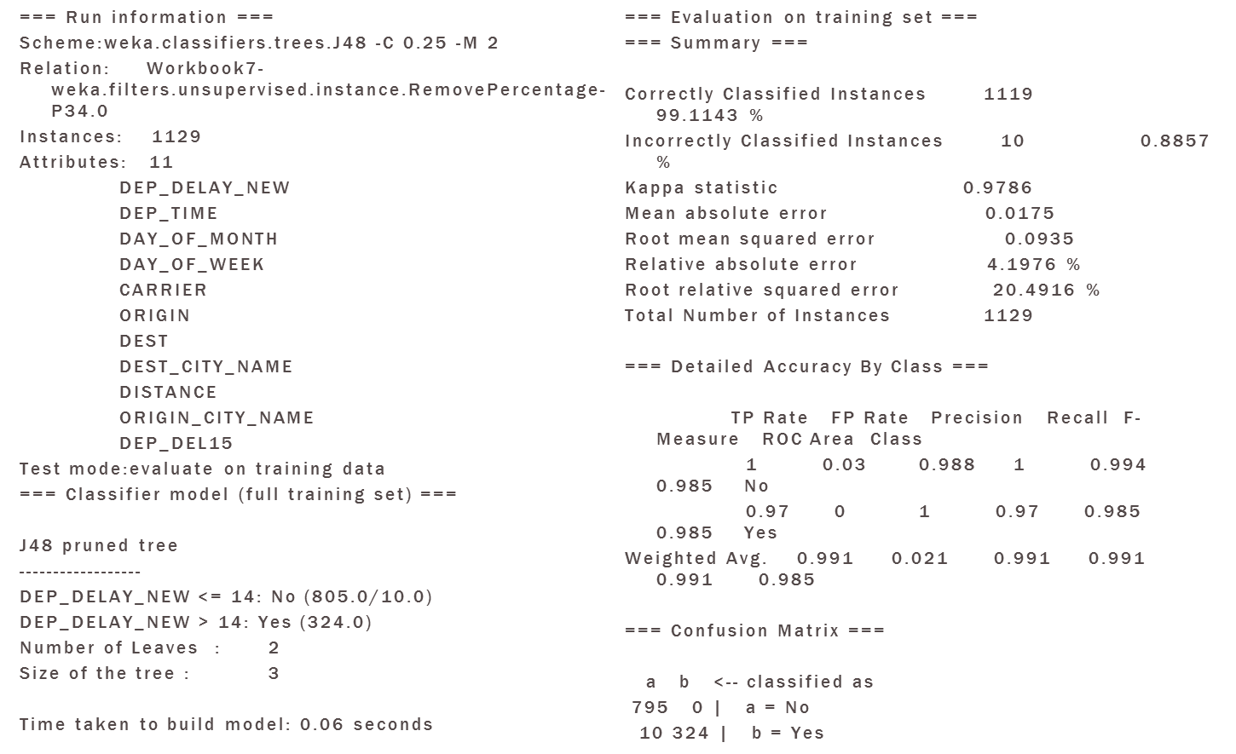
TRAINING SET RESULT
MIS 637 Knowledge Discovery in Databases

Slide 28
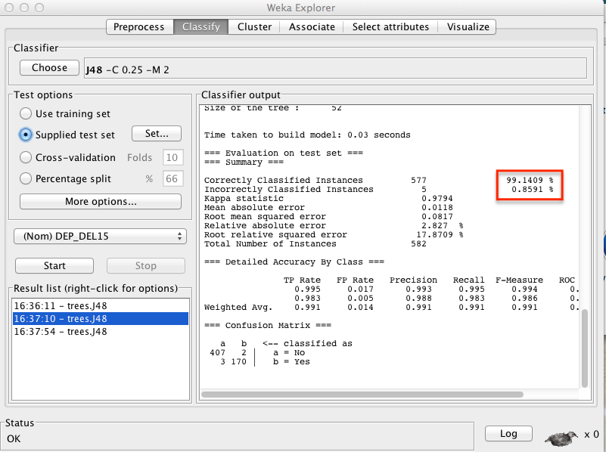
TESTING
To test the training model, now we use the test dataset.
Choose Test Options as Supplied test data and select the test dataset.
Define class attribute as DEP_DEL15, which is the target/output attribute.
MIS 637 Knowledge Discovery in Databases
Notes:
The number of correctly classified instances are 577/1582 records with an accuracy of 99.1409 %
The confusion matrix shows that there were total 172 flights that were delayed. 2 out of 172 are classified as wrong.
Also 410 of total flights which were not delayed. 3 out of these have been classified wrong.

Slide 29
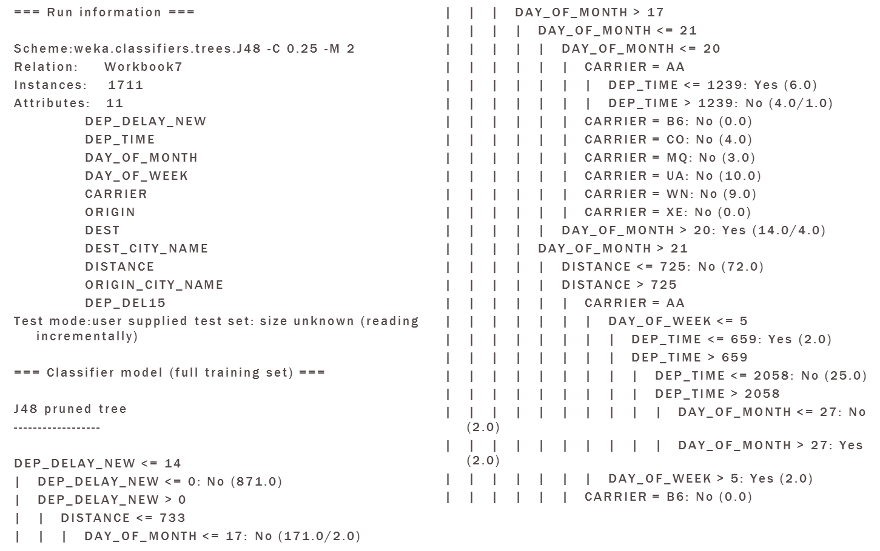
TESTING SET RESULT
MIS 637 Knowledge Discovery in Databases

Slide 30
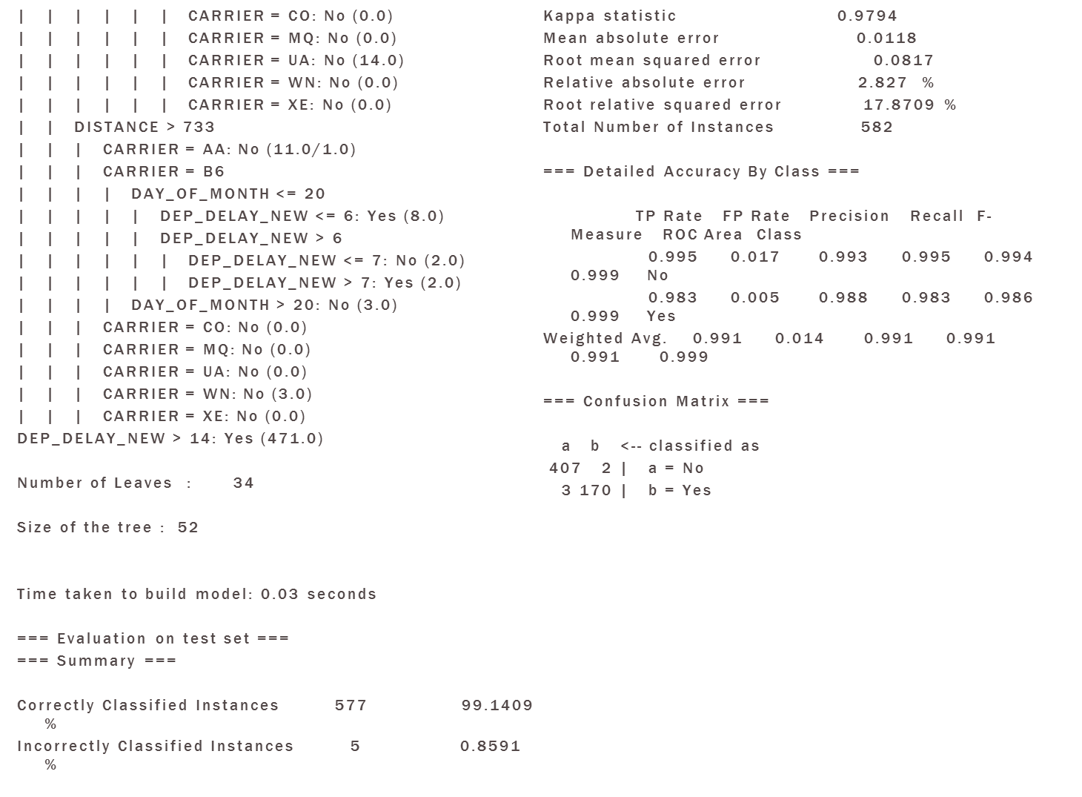
MIS 637 Knowledge Discovery in Databases

Slide 31
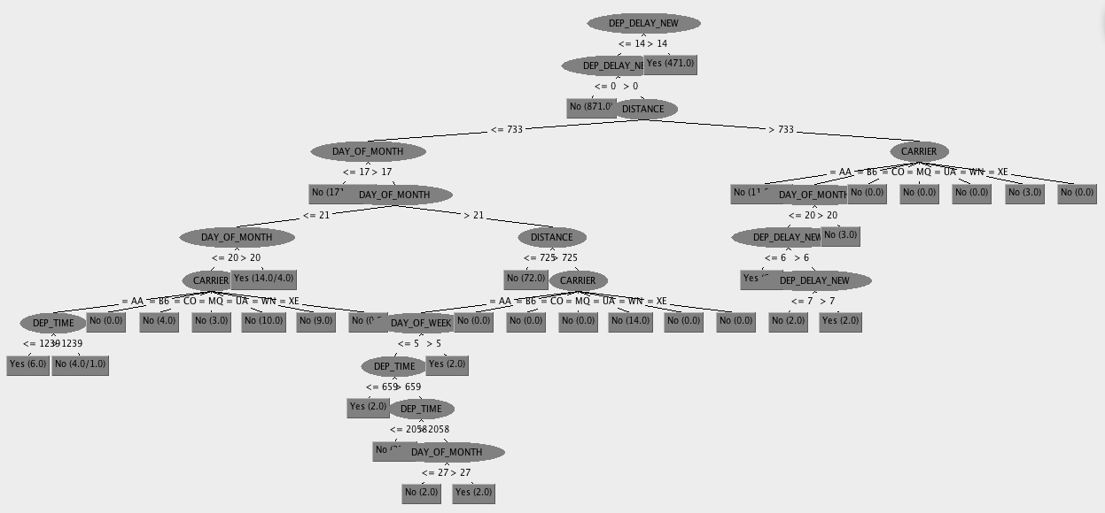
DECISION TREE
MIS 637 Knowledge Discovery in Databases

Slide 32
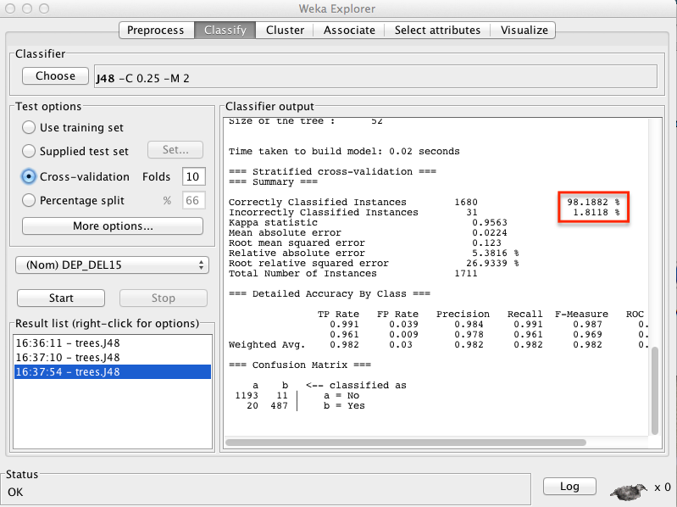
CROSS-VALIDATION
Choose Test Options as Cross-validation and choose folds as 10.
Define class attribute as DEP_DEL15 which is the target/output attribute.
When the full data was used 98.1882% of the instances were correctly classified.
MIS 637 Knowledge Discovery in Databases

Slide 33
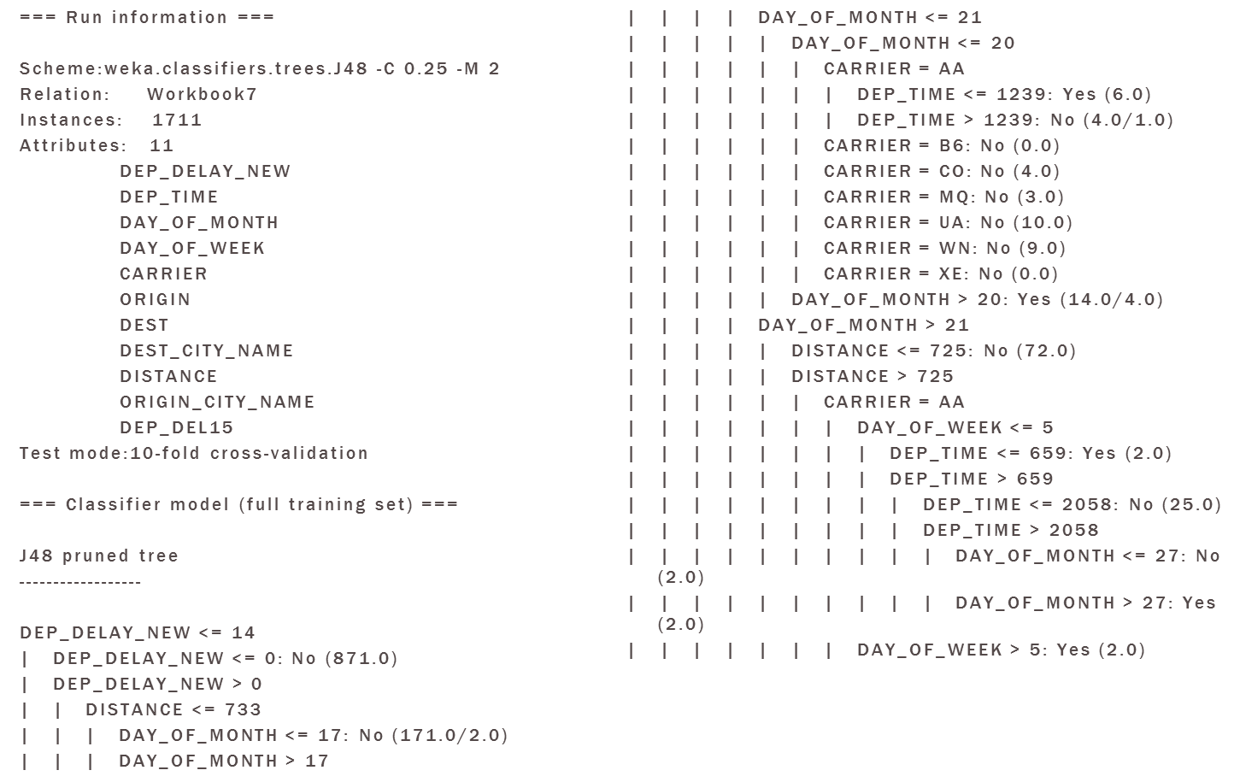
CROSS-VALIDATION RESULT
MIS 637 Knowledge Discovery in Databases

Slide 34
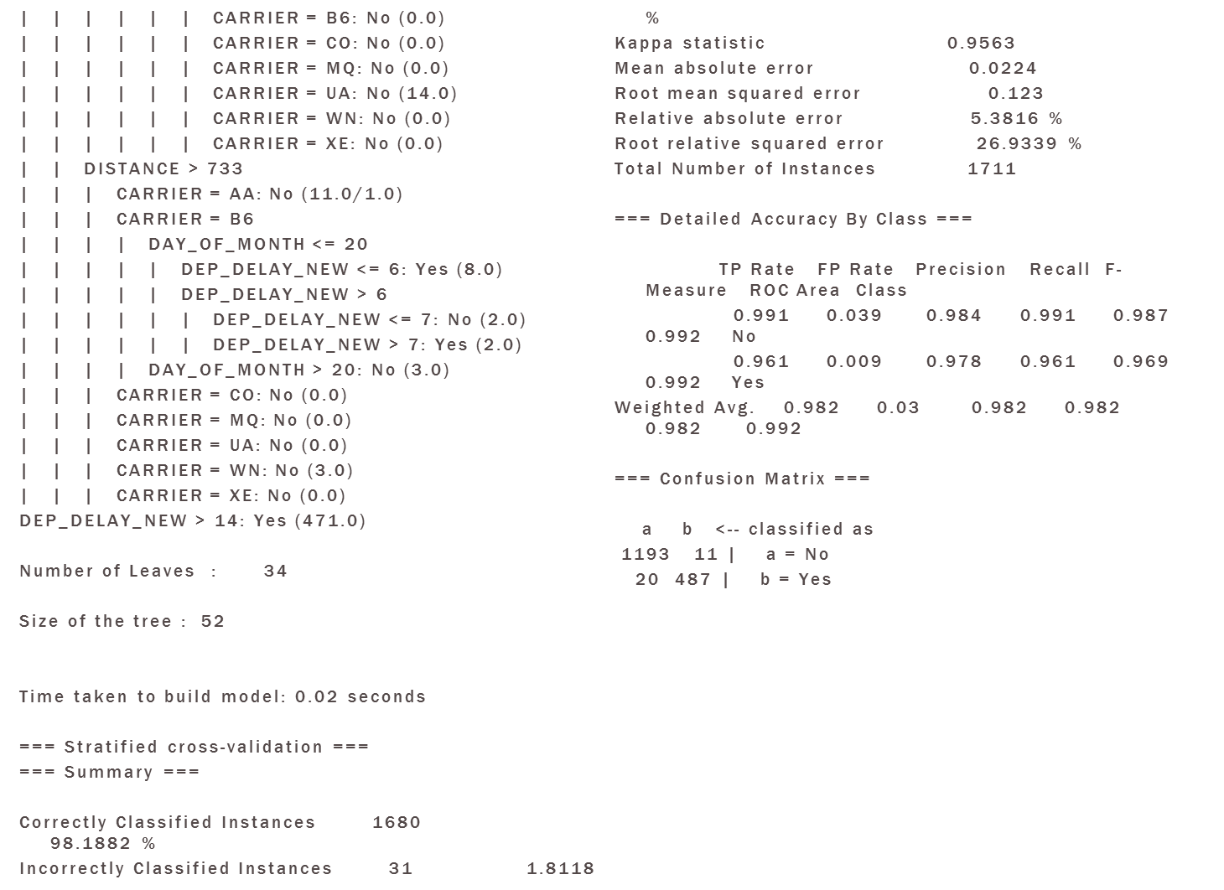
MIS 637 Knowledge Discovery in Databases

Slide 35

EVALUATION
We could see from the training data, test data and the decision tree that the attributes DEP_DELAY_NEW, DEP_TIME, DAY_OF_MONTH, DAY_OF_WEEK, CARRIER, ORIGIN, DEST, DEST_CITY_NAME, DISTANCE, ORIGIN_CITY_NAME and DEP_DEL15 are the important factors required to predict the flight delay.
From our model and analysis we were able to make good predictions on the basis of the key attributes.
Despite the success of our model however, we need to include the weather data, which is obviously is directly responsible for many flight delays.
MIS 637 Knowledge Discovery in Databases

Slide 36

DEPLOYMENT
Possible applications:
Flight delay forecasting – This model could be used to predict the flight delays on different individual flights. This information will be very useful to manage customer expectations when a flight delay is expected.
Mobile Apps/ Websites – This will be very useful for customers to get information about the flight delay few hours/days prior to their travel dates.
Premium Ticketing – Majority of the ticketing happens online these days, travel agents could make use of this model to price tickets.
MIS 637 Knowledge Discovery in Databases
Notes:
When there is prior information about the delays then the airline can plan for accommodation and food for passengers, increased staff to handle irate passengers, etc.
It also may provide delay information and selling advertising for alternate flights / modes of transportation to destination.
With a majority of booking happening online these days, Online Travel Agents (OTAs) could use information from this model to price tickets differentially. For e.g. there may be set of customers that may be highly sensitive to ticket prices but are highly insensitive to flight delays (such as students, leisure travelers etc). For such customers, OTAs can offer low priced tickets on flights with a high probability of delays.

Slide 37
REFERENCES
http://galitshmueli.com/content/business-analytics-using-data-miningJeffrey S. Simonoff, Analyzing Categorical Data, Springer-Verlag, New York, 2003, pp. 418, q. 9
http://www.transtats.bts.gov/DL_SelectFields.asp?Table_ID=236&DB_Short_Name=On-Time
Data mining with WEKA, Part 1: Introduction and regression, (http://www.ibm.com/developerworks/opensource/library/os-weka1/index.html)
Data mining with WEKA, Part 2: Classification and clustering, (http://www.ibm.com/developerworks/opensource/library/os-weka2/index.html)
http://cs-people.bu.edu/dgs/courses/cs105/hall_of_fame/timoteo.html
Lecture Notes and Slides
Daniel T. Larose, Discovering Knowledge in DATA: An Introduction to DATA MINING, John Wiley, 2005
http://maya.cs.depaul.edu/~Classes/Ect584/Weka/
MIS 637 Knowledge Discovery in Databases

Slide 38
THANK YOU!!
MIS 637 Knowledge Discovery in Databases

